Slide 1
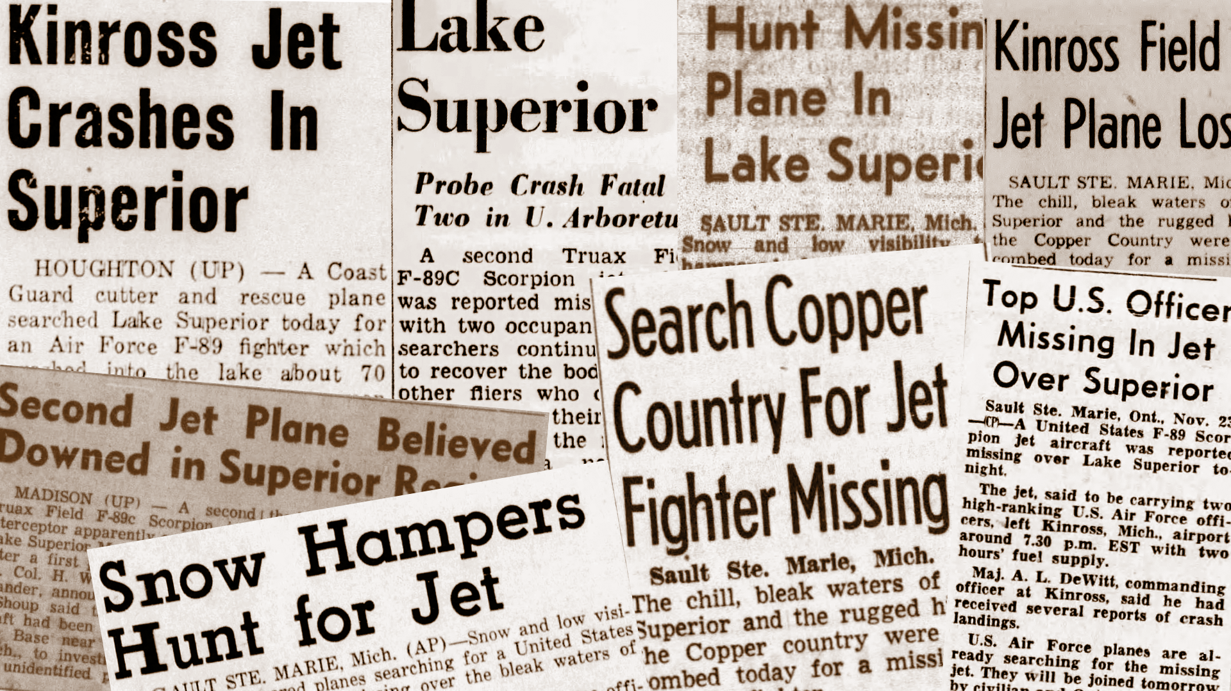



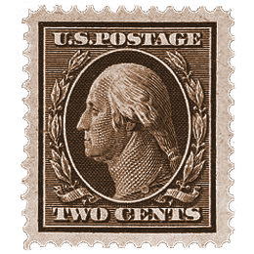


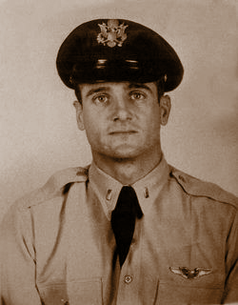


The Kinross
Incident
November 23, 1953
by: Virginia Kate Moncla

Slide 2
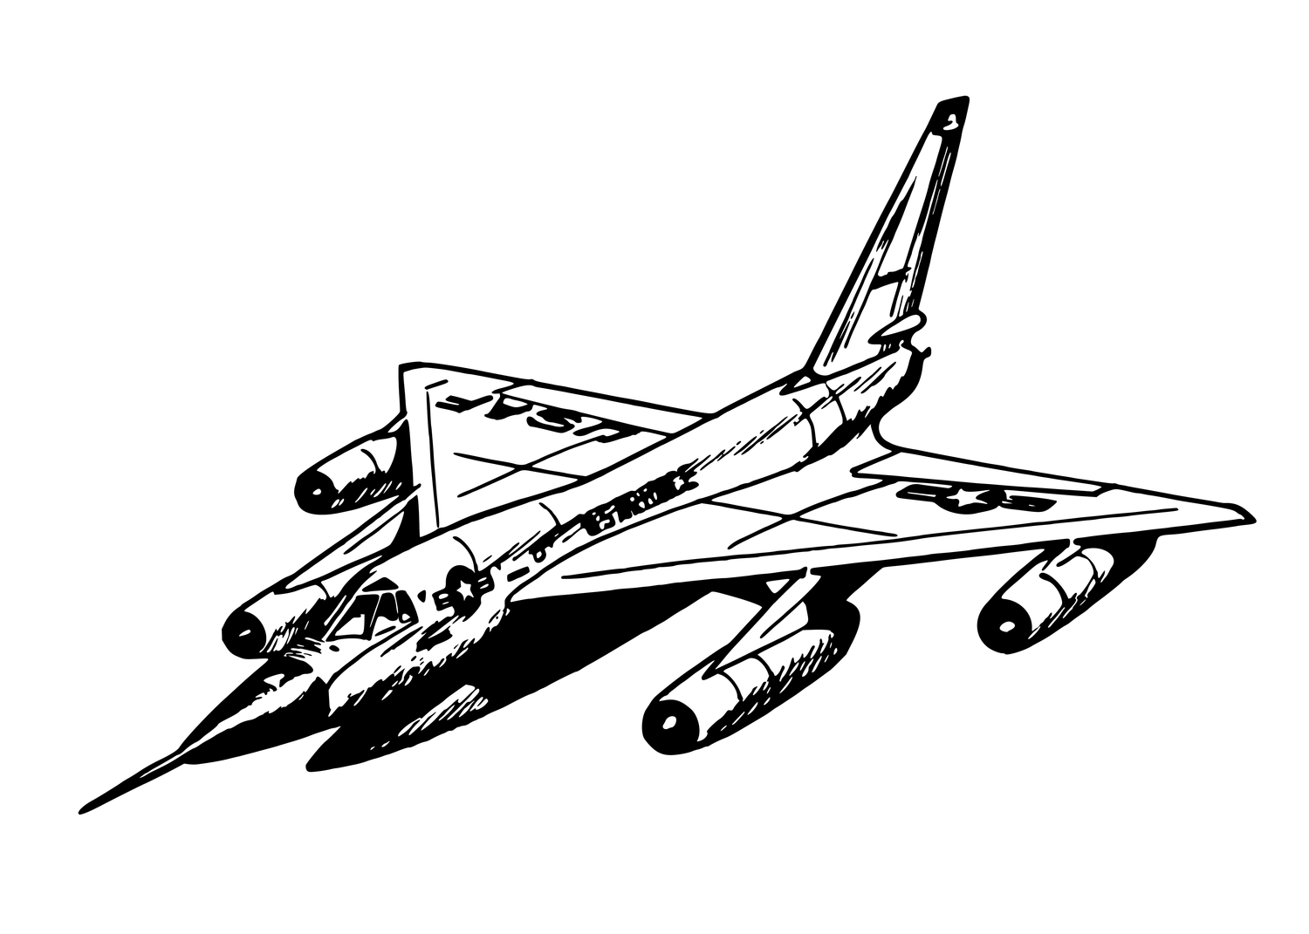

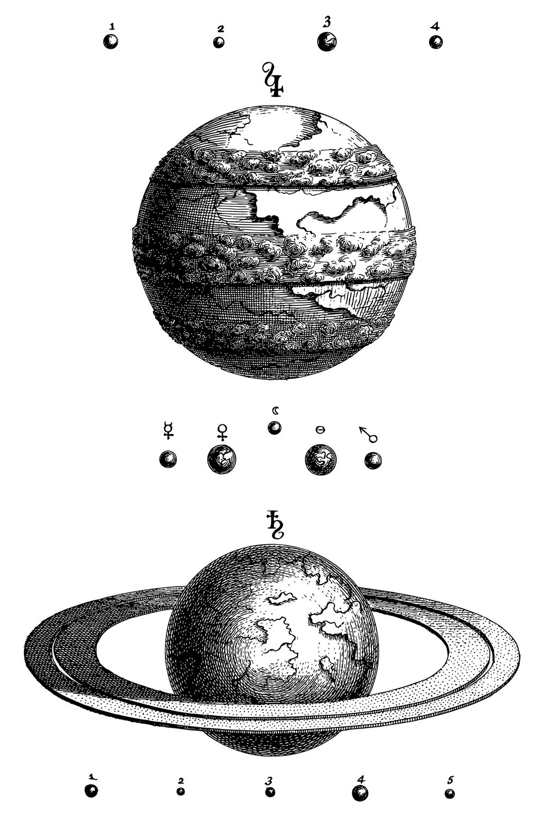
World Context
Cold War
UFO Madness
In the early 1950s, as the Cold War began, the U.S. rapidly built up its air defense with new bases and radar stations. When the Kinross Incident happened, this defense as well as the recently restructured military was still new and rudimentary. There was also multiple “UFO” sightings that were later debunked to be Soviet planes or U.S. balloons.
In the summer of 1947, “Flying Saucer Madness” swept the U.S. after reports of seeing flying crafts and the Roswell Incident emerged. Since the late 1940s, beliefs about aliens and their reasons for visiting Earth have shifted many times within the UFO movement. The accounts of extended contact with aliens in the early 1950s were vastly different from today's chilling stories of UFO abductions.

Slide 3
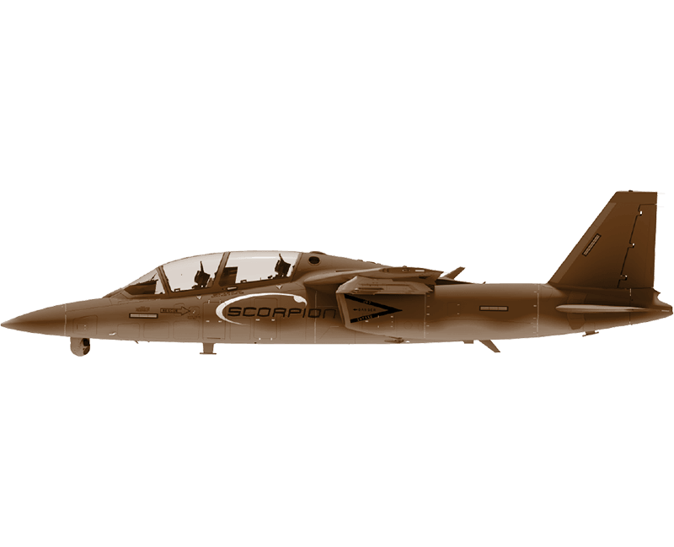
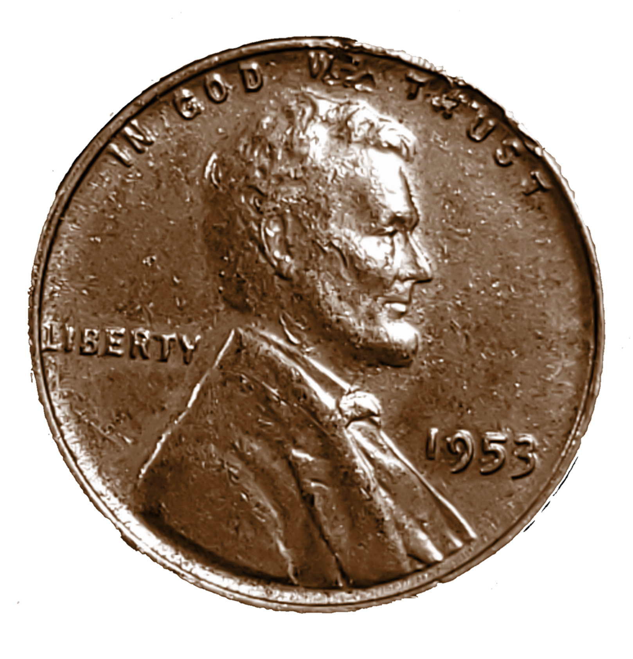




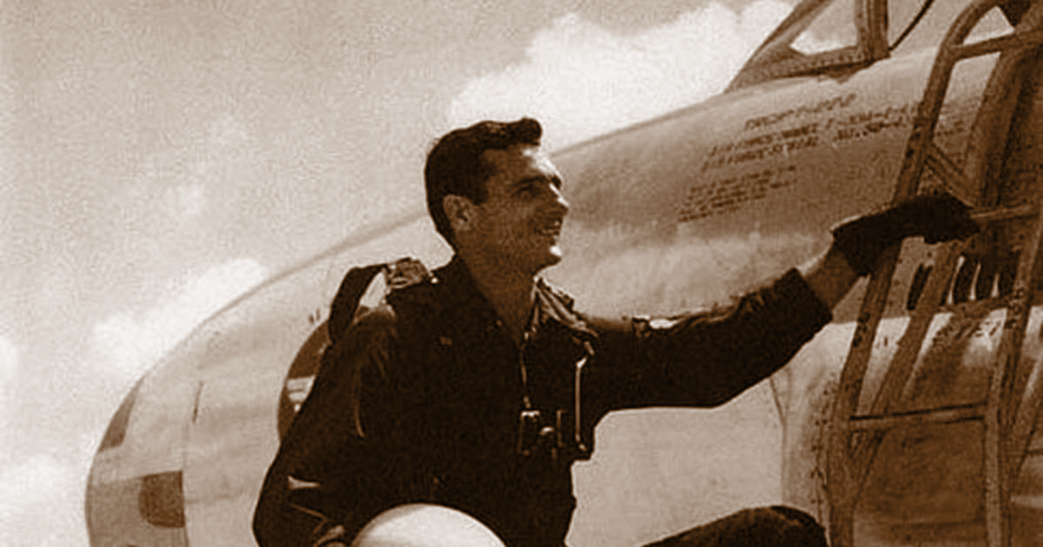

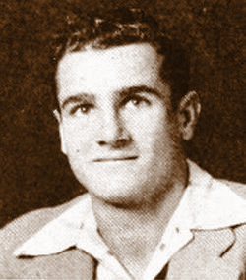
Felix Eugene
Moncla Jr.
First Lieutenant and Pilot
Early Life
Military Career
Health
Born in Mansura, Louisiana on October 21, 1926, “Gene” Moncla was educated at USL and born to a WWI veteran. He attended college at SLI, now UL, to be a doctor and play football.. He came from a large southern family, and married Bobbie Jean Coleman and had two children.
Felix Eugene or “Gene” as friends and family called him enlisted in the army at the start of WWII and reenlisted into the Air Force at the beginning of the Korean war. He became a lieutenant and clocked numerous flight hours in every condition.
Moncla allegedly suffered from bouts of vertigo, but the USAF did not mention vertigo as a possible cause of crash in their report. However, it was the personal belief of his squadron that he had a vertigo attack and crashed.

Slide 4
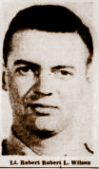
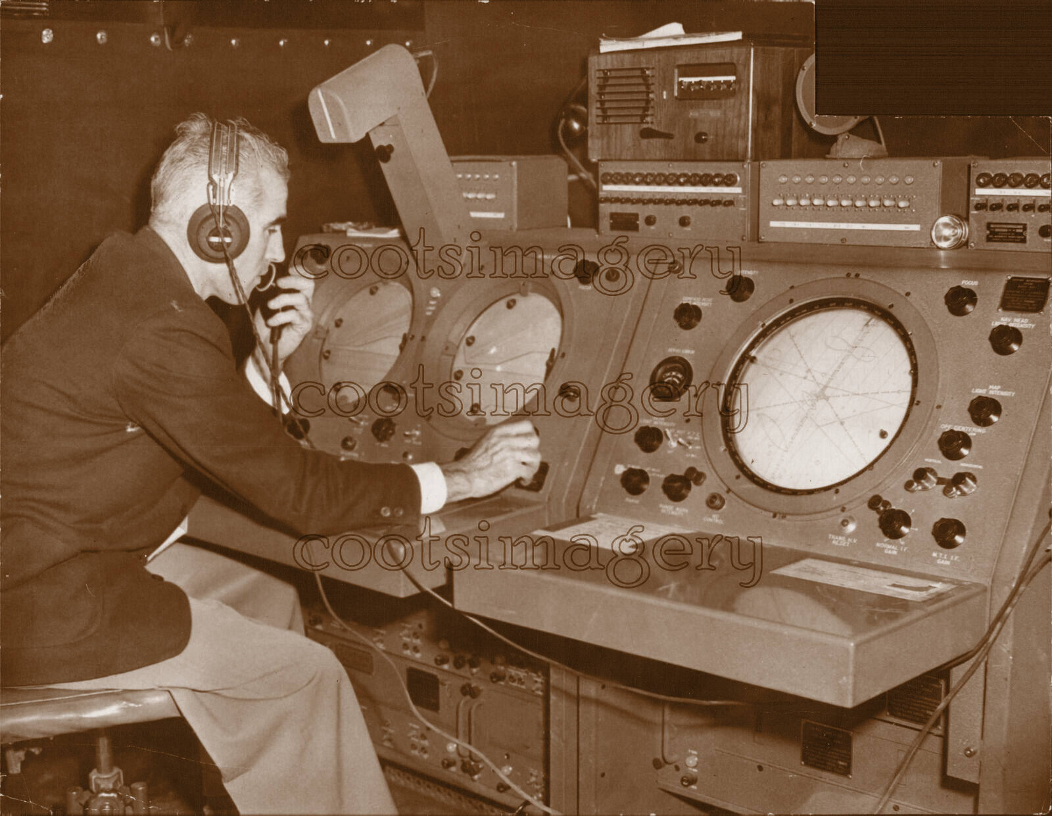
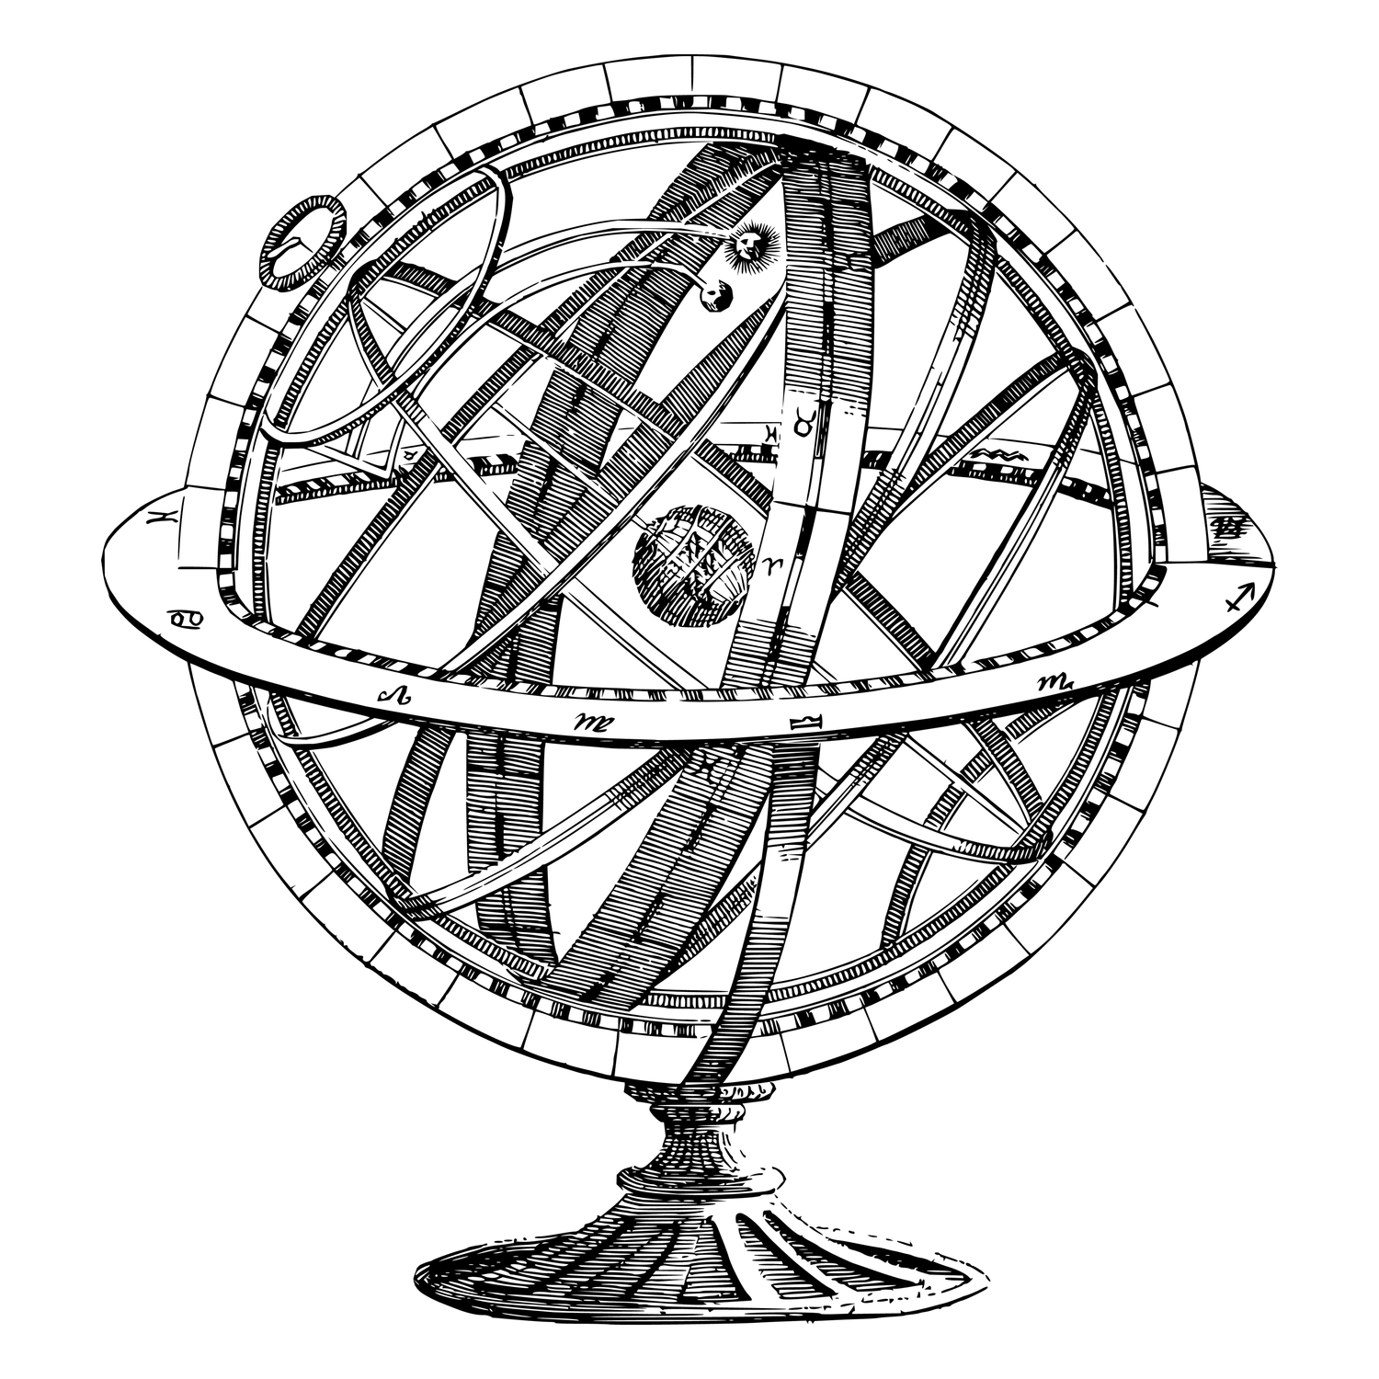

Robert
Wilson
Second Lieutenant and radar operator
Wilson was born in Ponca City, Oklahoma in 1931. He showed interest in aerospace and technology as a child. Little information is available on Wilson’s early life or military service. He had one sister and at 22, was new to the service.
Early Life and Military Service
Health
Wilson was believed to have been in perfect health, and was not known to have any conditions that could cause him to crash a plane.

Slide 5
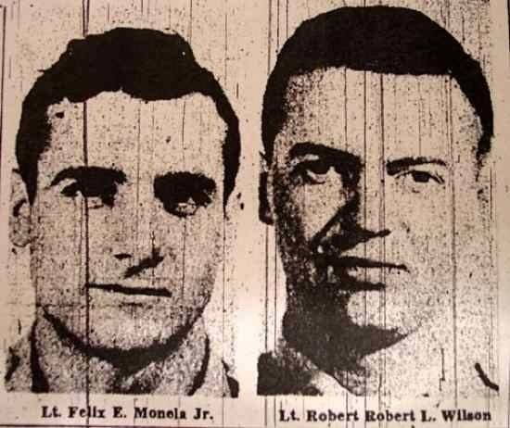
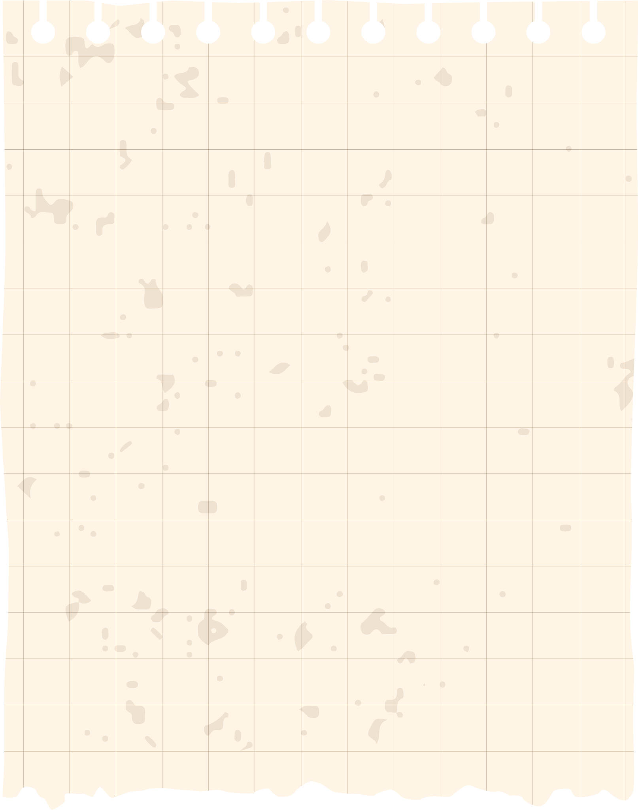

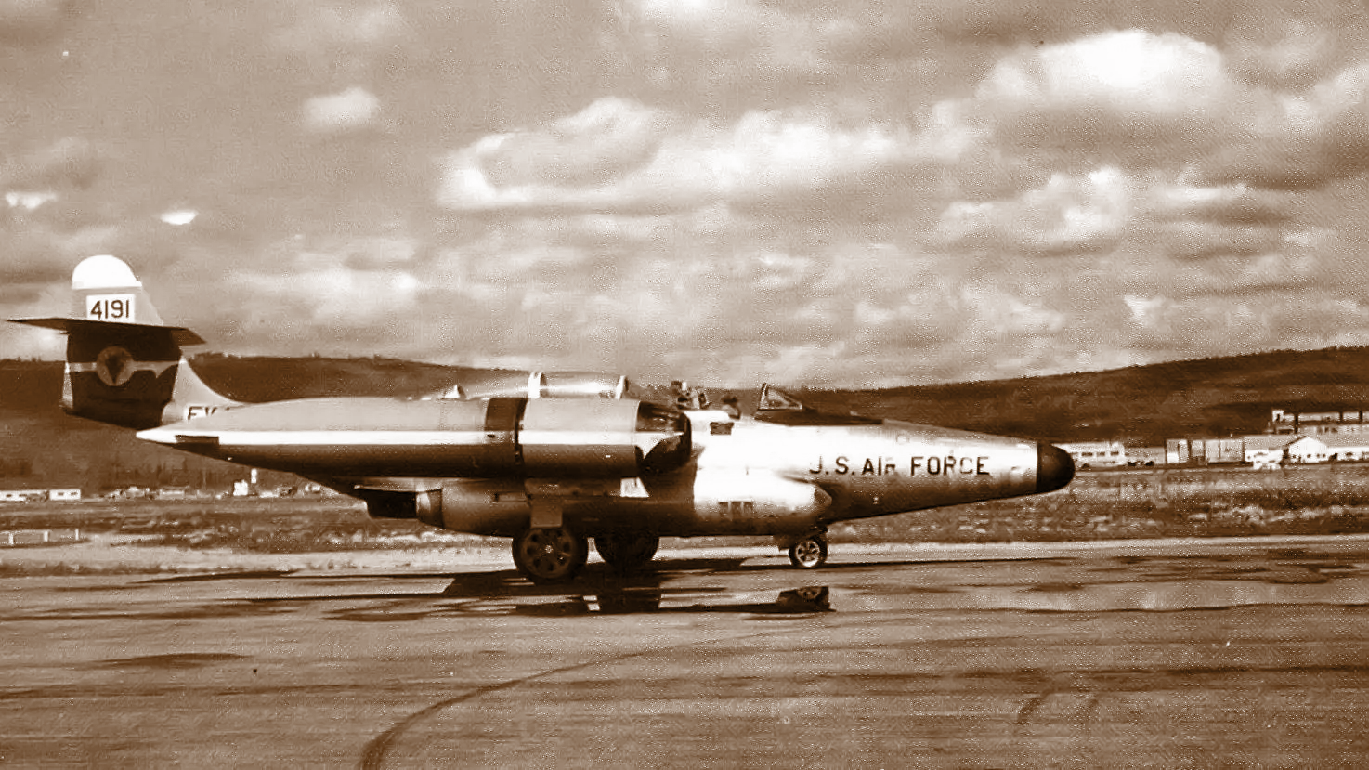
Disappearance
Moncla and Wilson were alerted to go to track a UFO flying over Lake Superior in an F-89C Scorpion. Radar and Ground Control tracked the Scorpion and an unknown object as separate blips on the screen. They appeared to merge, then the single blip vanished, suggesting a collision. The intercepted aircraft was identified as a Royal Canadian Air Force Dakota, but the Canadian Air Force denied involvement. Some UFO researchers associate the disappearance with "flying saucer" activity, calling it "The Kinross Incident."
Multiple extensive aerial and lake searches were carried out by both the RCAF and USAF with no sign of the plane or pilots ever found.

Slide 6


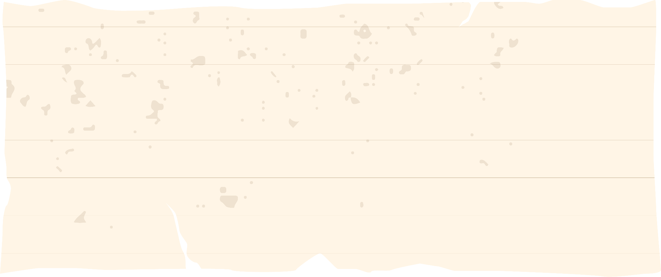
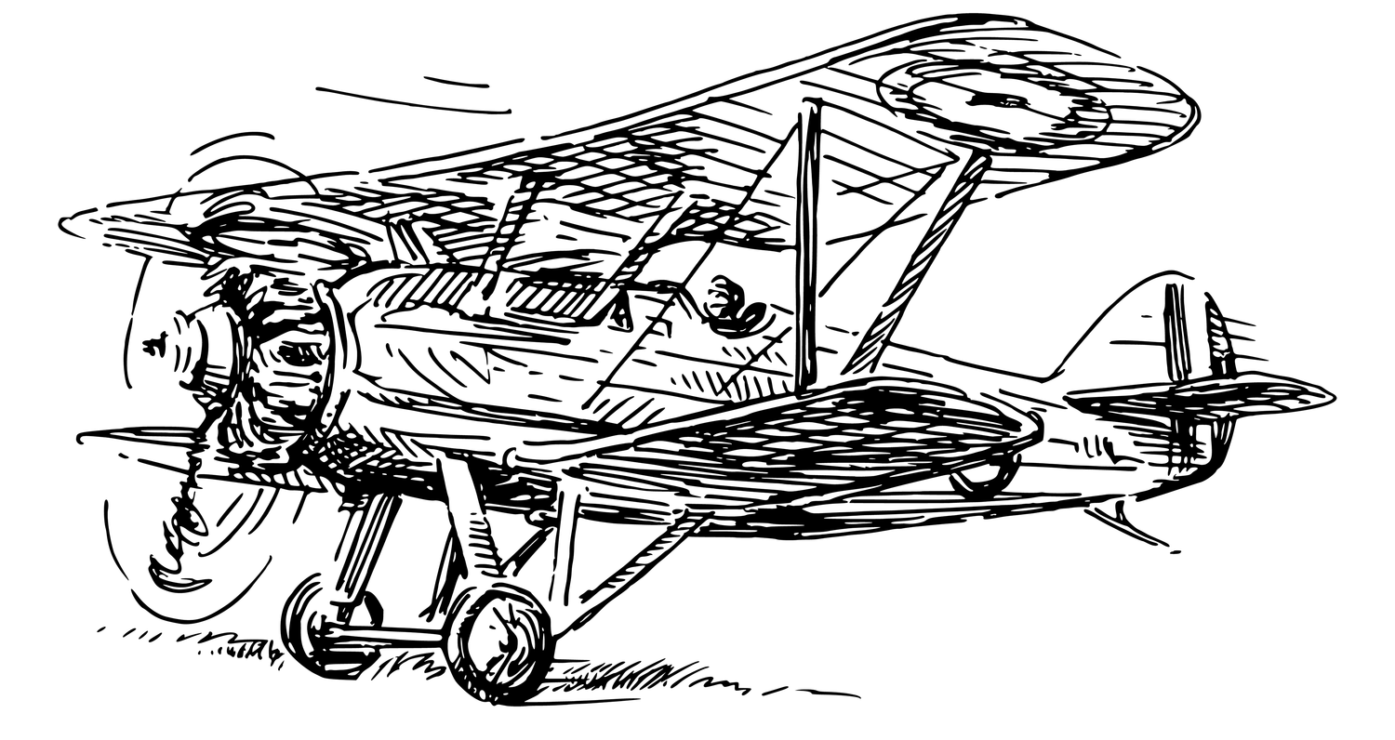
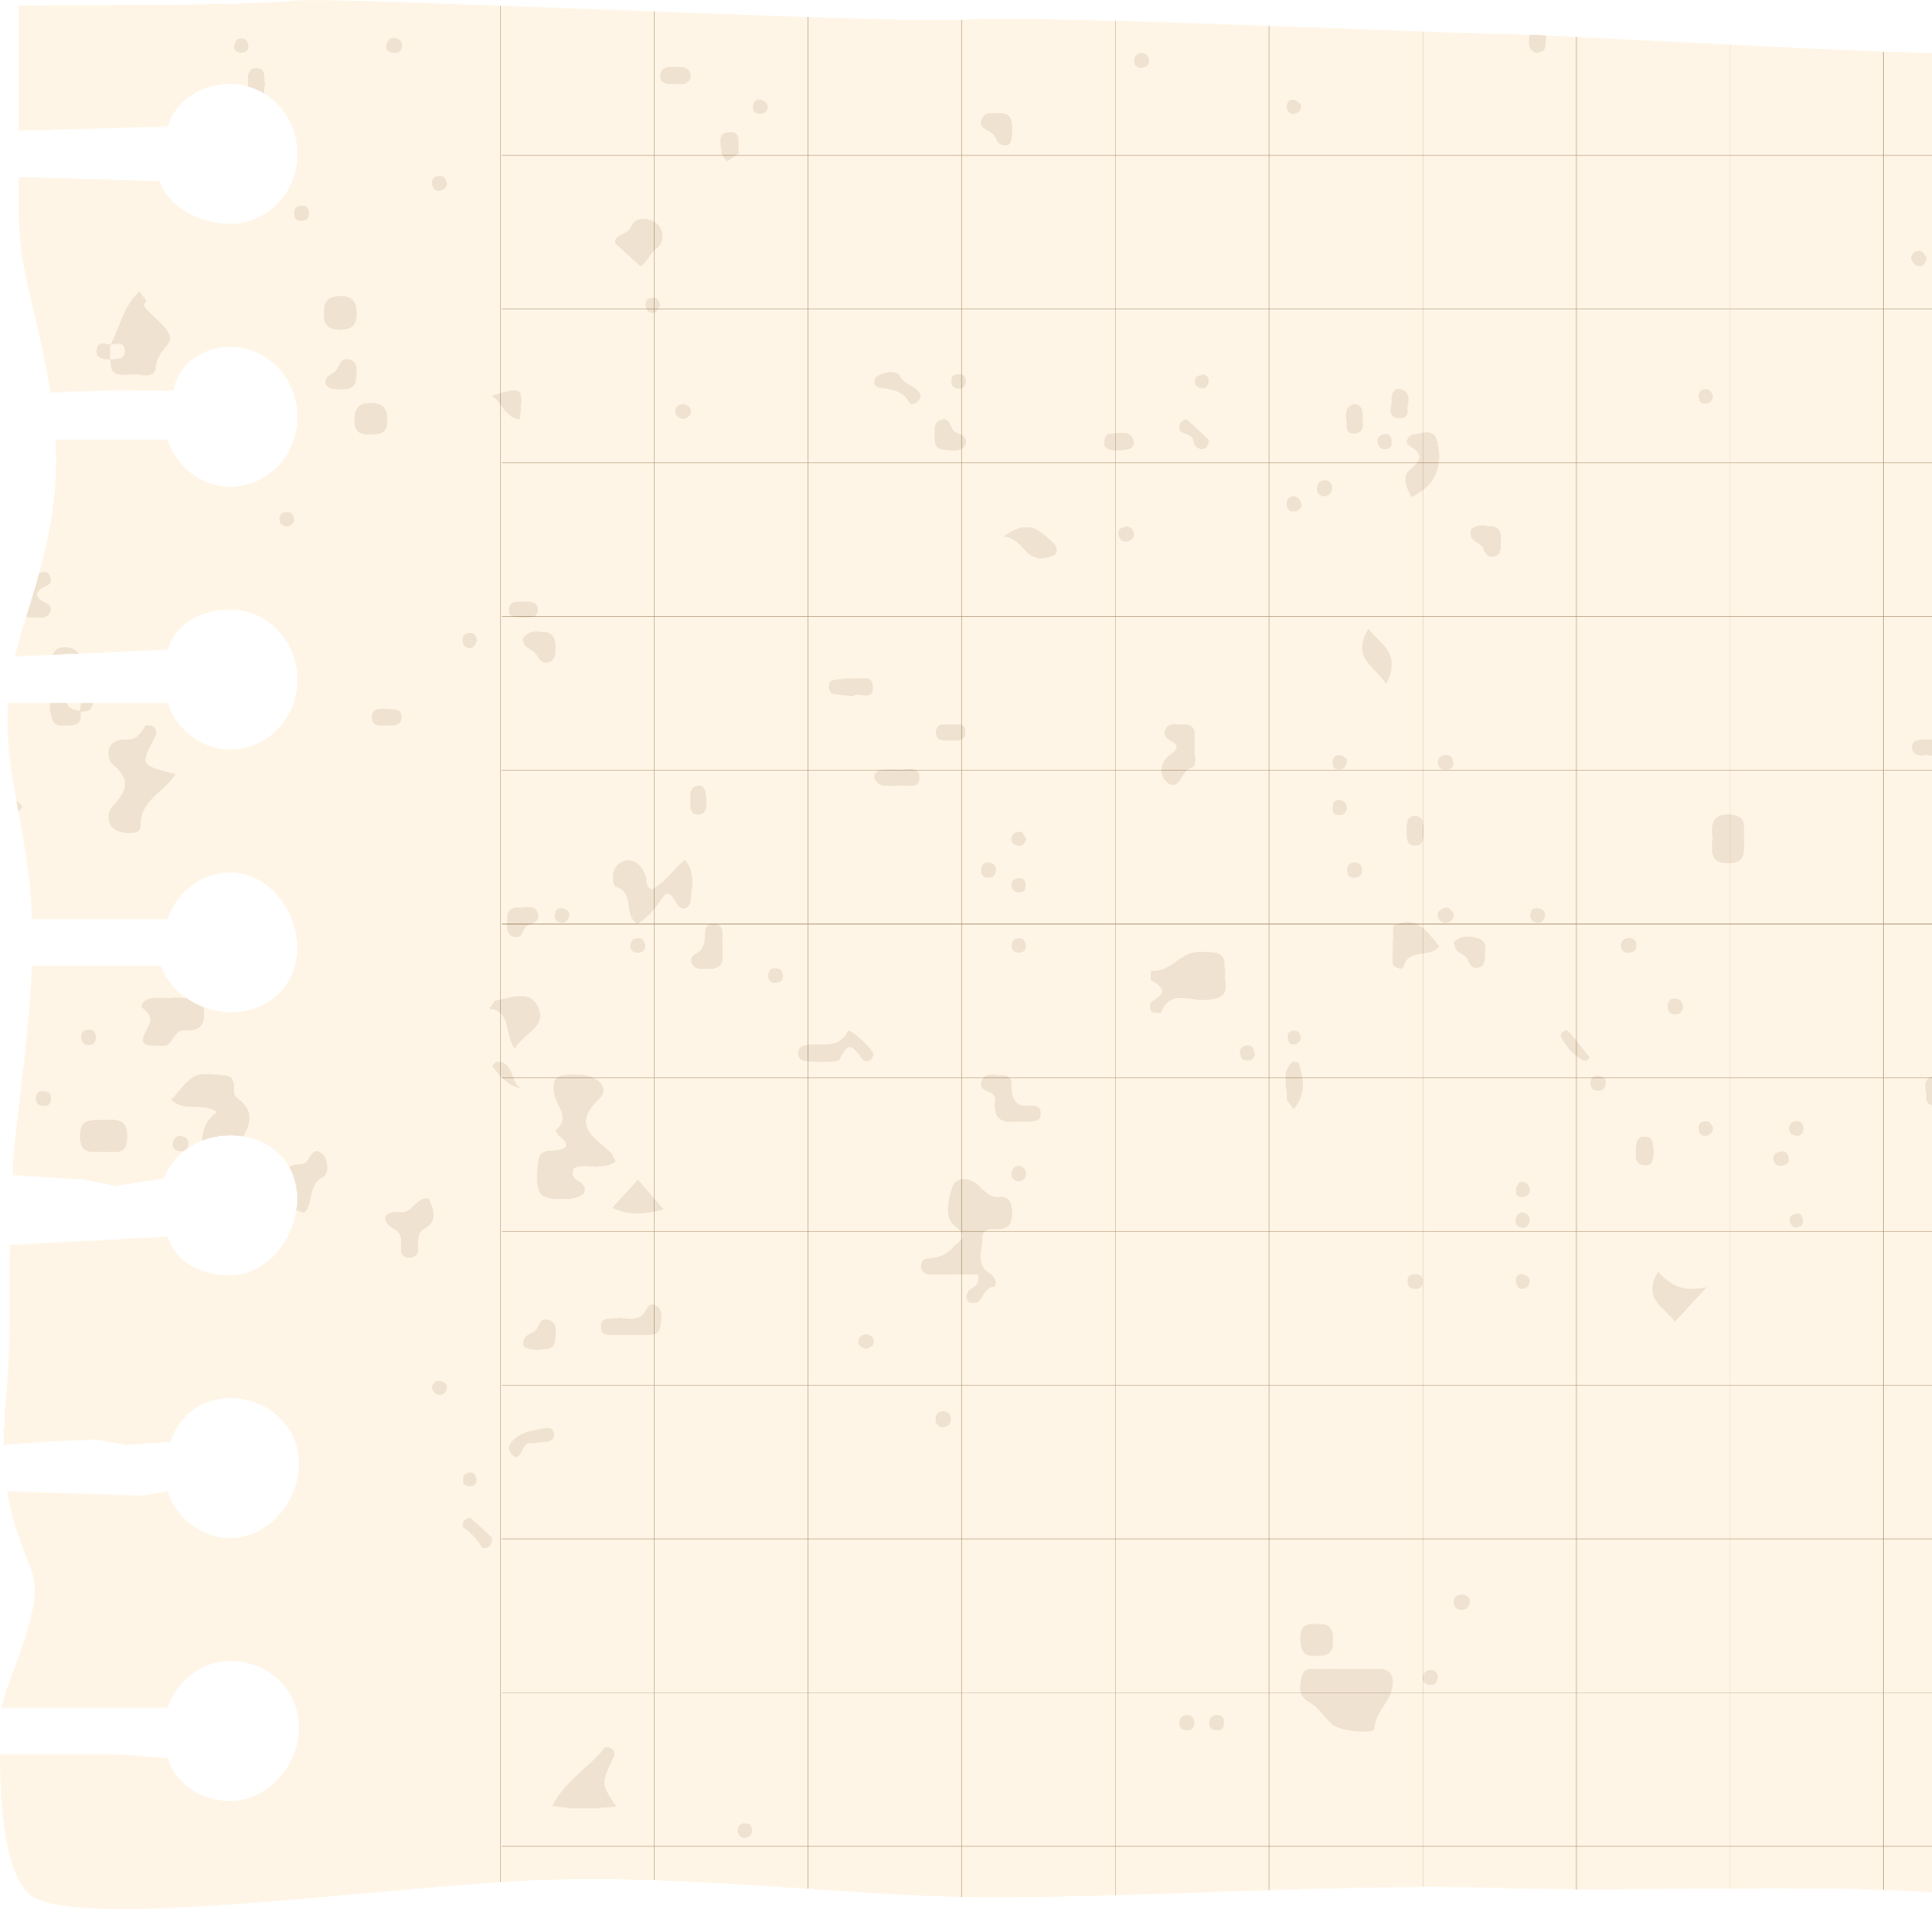
Timeline of November 23
Location: Kinross Air Force Base in Michigan and flight was over Lake Superior
7:30 AM | Preflight inspection on F-89C Fighter Jet carried out with no dilemma.
11:45 AM | Aircraft scrambled and returned to base.
12:45 PM | Post-Flight service and inspection carried out. Plane given “OK”.
6:17PM | Radar operators spot UFO on radar moving at extremely fast speeds.
6:22 PM | Moncla and Wilson take off in pursuit of UFO.
6:47 PM | Pilots report poor radio conditions and were still in pursuit of UFO.
6: 52 PM | Final radio contact made.
6: 55 PM | Blips merge and one emerges on radar. Contact lost with plane.
7:15 PM | CAP sends 2nd. Lt. Howard Nordeck to search for missing F-89C, weather deteriorates.

Slide 7

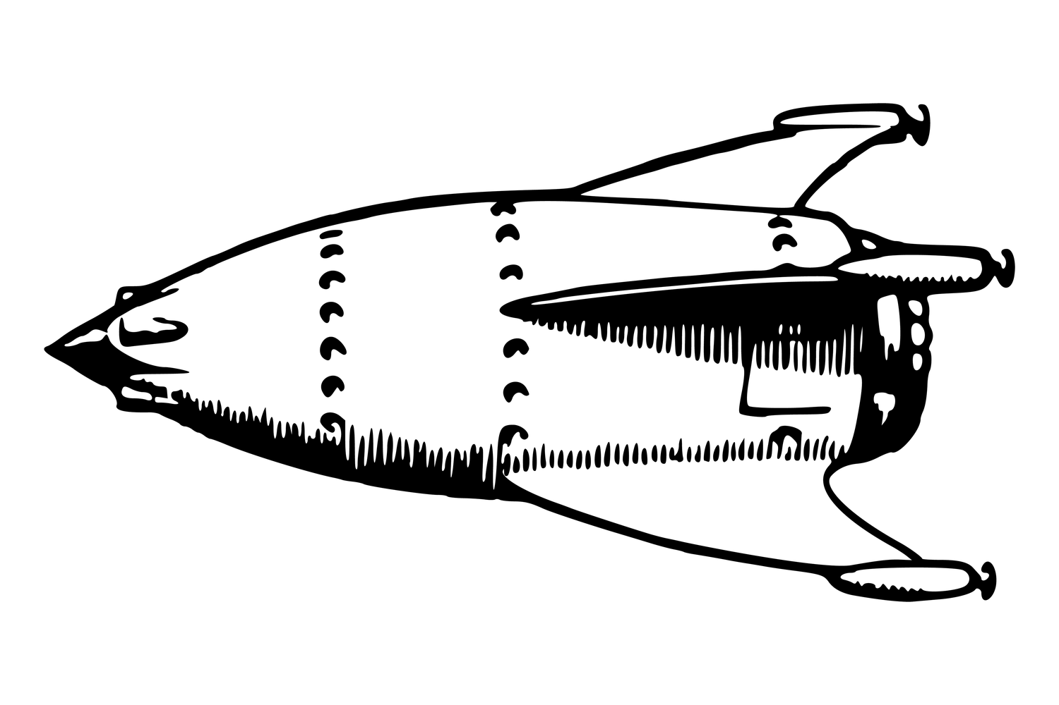


Three Possibilities
Alien Abduction
Human
Error
Russian
Interference
Obviously alien abduction was a possibility, especially since they were in pursuit of a UFO and vanished without a trace. The lack of plane pieces or human remains support the theory that they were abducted whole out of the sky, as they just vanished off the radar.
There is also the possibility that one or both of the pilots crashed due to an accident or human error. The weather report also noted cold temperatures and ice, but no pressure issues or turbulence. The plane was checked extensively the day of the incident, so machine error is more unlikely than human error.
Tensions between the United States and Russia were heating up after the start of the Cold War in March of 1947. It was widely believed that the Soviets were flying reconnaissance missions over Canada and the Great Lakes. It was speculated that the UFO was a secret Russian craft capable of crazy speeds.

Slide 8
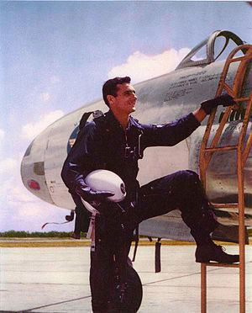
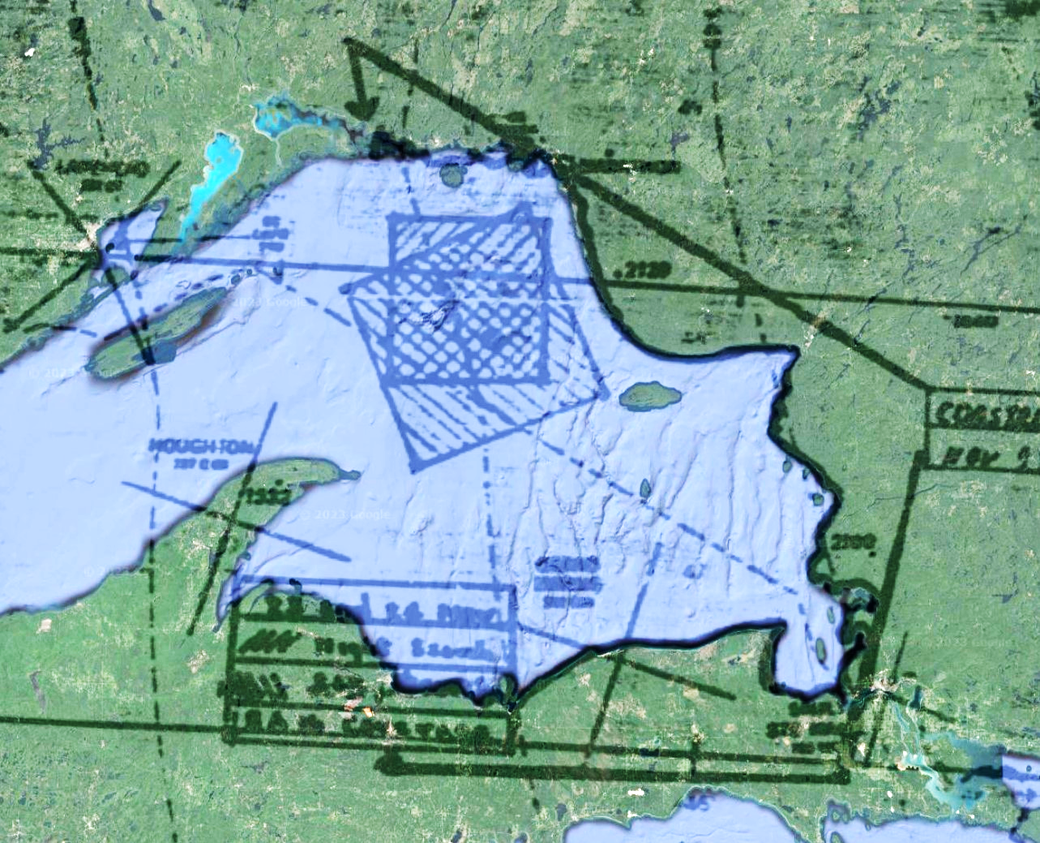


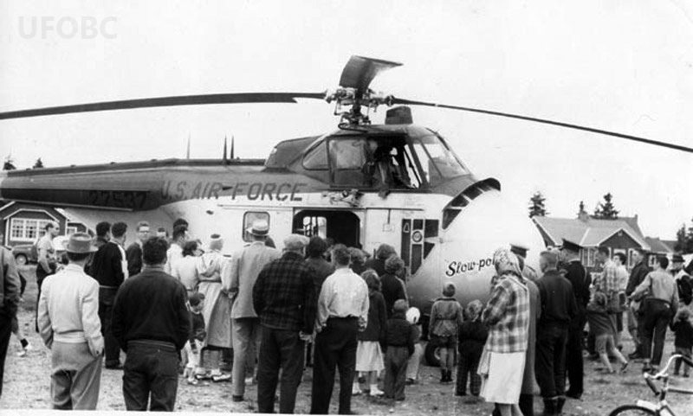

Gathering Evidence
The United States Air Force conducted an investigation, most of which only became available with the freedom of information act. The investigation and search for evidence was thorough, but not many other causes for disappearance besides crash were discussed in the findings.
In 1968 some plane parts washed up on the shore of Lake Superior, but they were found to not have been form an F-89 Scorpion.
In 2006, a bogus dive company claimed to have found the plane remains in the lake, but their claims were soon debunked.

Slide 9

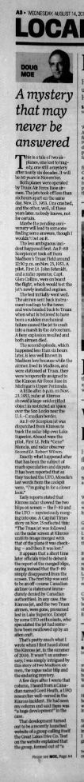

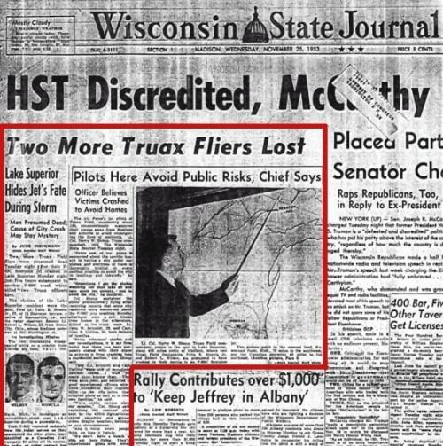

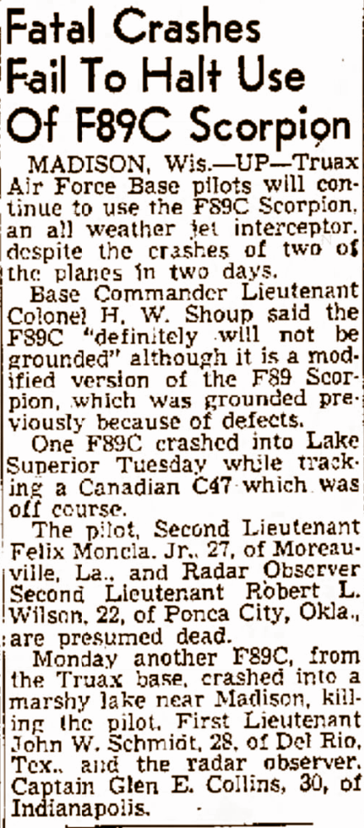
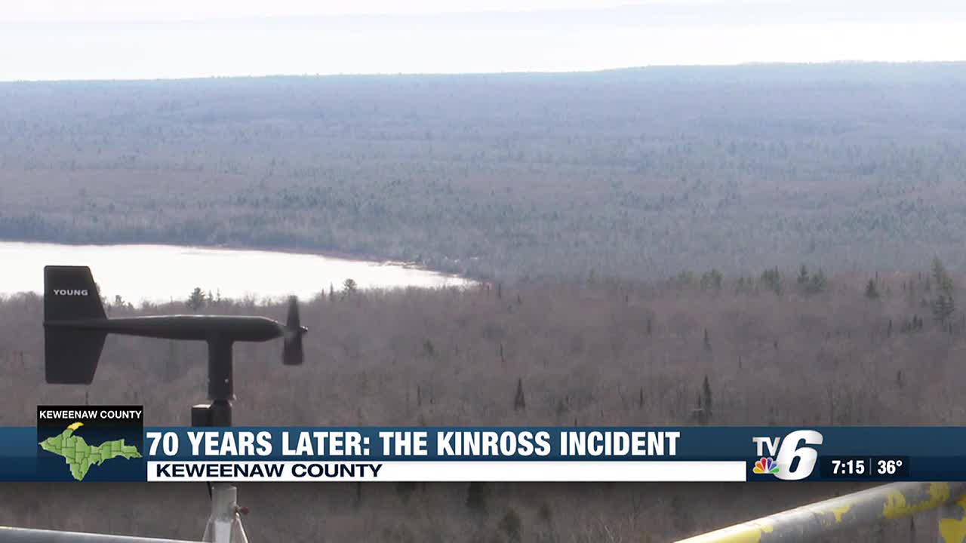
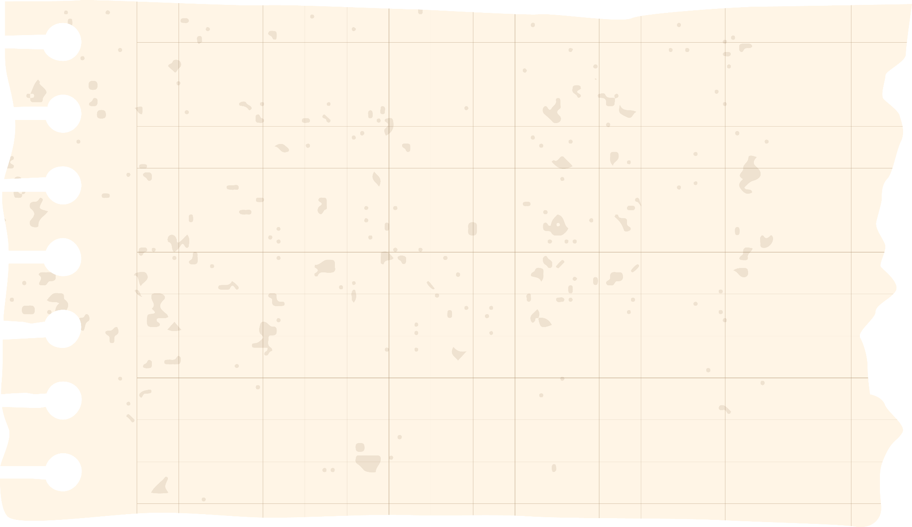
Media Coverage
Newspaper
Multiple local and national newspapers covered both the initial crash and subsequent investigation. Multiple articles with false and unverified facts also circulated, perpetuating conspiracy.
The Kinross Incident is still occasionally revisited and dissected in media, and it has also been sensationalized. People are fascinated by its unsolved stature, and the possibility of conspiracy.
Conspiracy Groups
Multiple UFO and conspiracy groups became obsessed with the Kinross Incident citing a greater government coverup, Russian interference, alien interference, black holes, and more as an explanation for the odd disappearance.

Slide 10
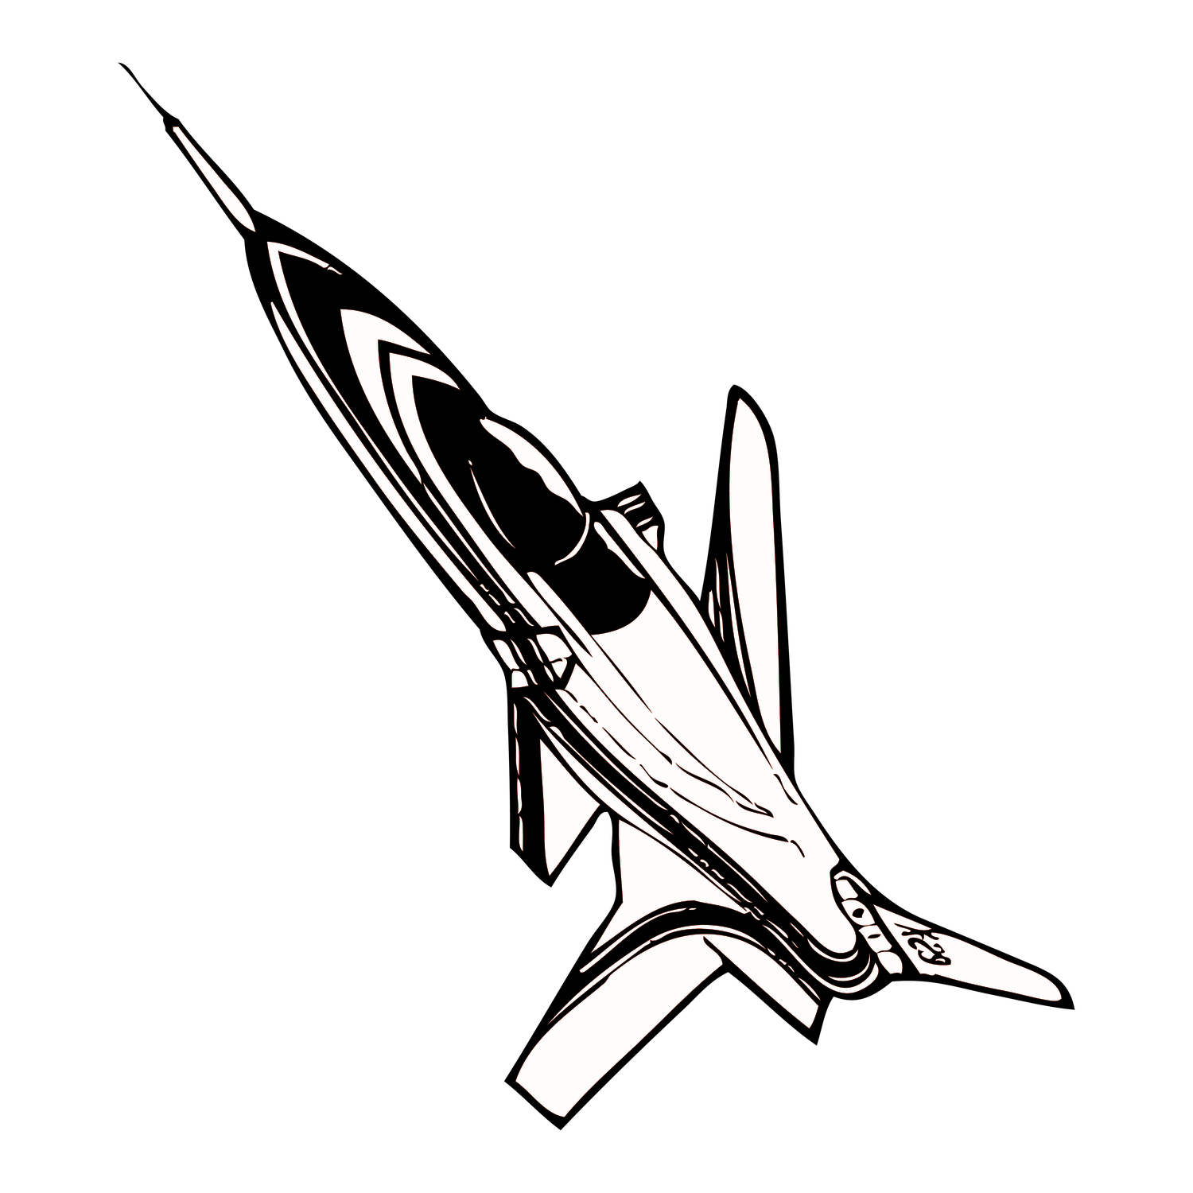



USAF Findings
Matinence
Pilot Error
Search
F-89C Jets had issues, but Moncla’s plane was fine and passed multiple inspections on the day of the crash.
Moncla’s squadron said he suffered occasionally from vertigo, and Wilson was far less experienced, so there is no evidence to support but it could’ve been pilot error.
Multiple search rescue and recovery missions attempted to retrieve or find the planes or pilots. The search was intensive and coordinated. Both Canada and the U.S. combed the Great Lakes and surrounding areas. No verified sign of the planes or pilots were ever found, but there were other plane parts found and multiple hoaxes.
Weather
Weather was fair but visibility was low on Nov. 23, 1953, and there was ice but no expected turbulence or storms
Canada
The mystery blip was thought to be a RCAF plane, but it was later denied by Canada.

Slide 11
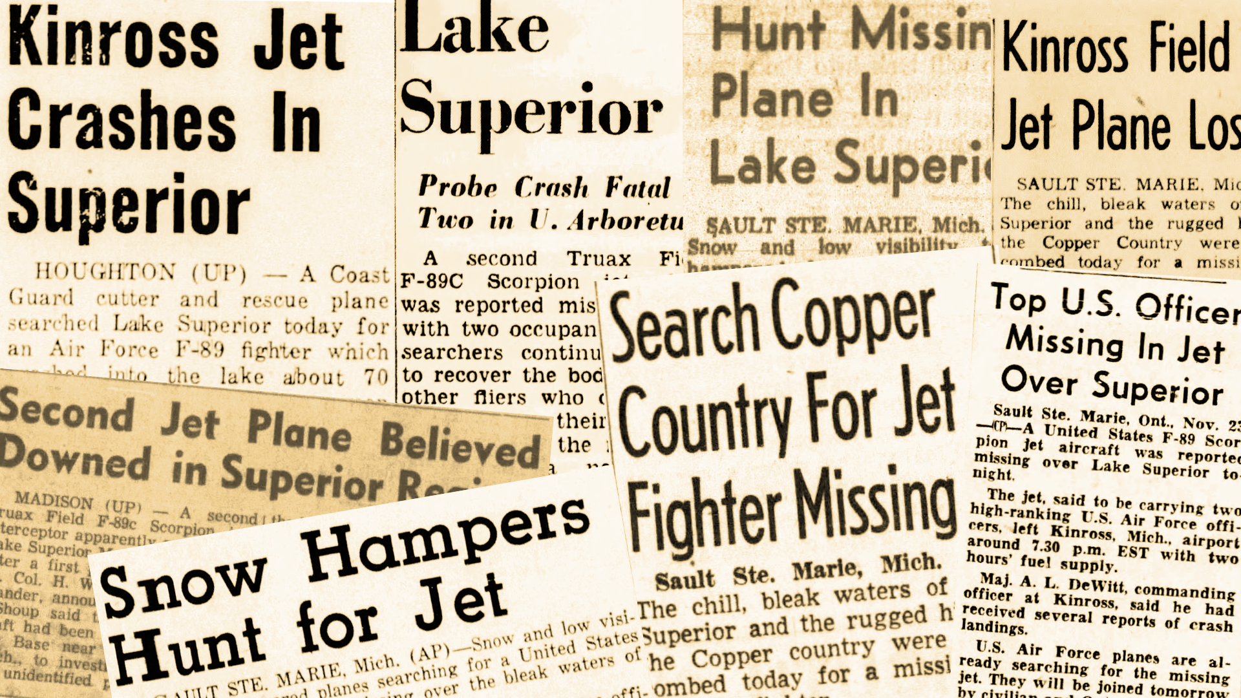
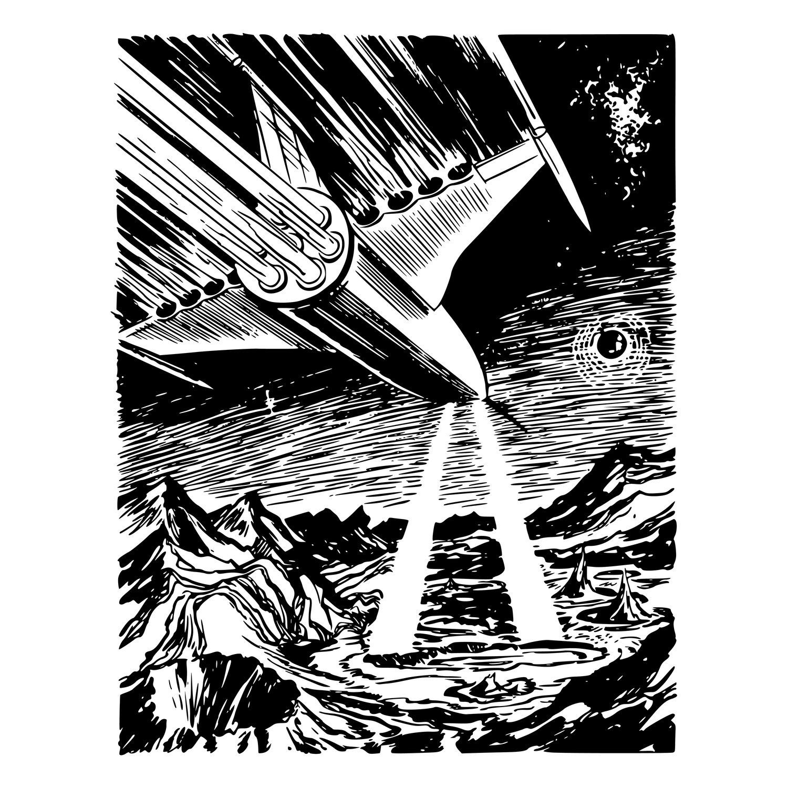

USAF CONCLUSIONS:
Because of the inability to determine the cause of the aircraft's disappearance the search was expanded to cover all possibilities, but was greatly hampered by bad weather and icing conditions.
Despite intensive aerial search and the careful \check of all ground reports, no trace of the missing aircraft could be found. After a conference with USAF authorities and with their concurrence active search was suspended the evening of 28 Nov 53.
The co-operation shown to the searchmaster, his assistant and the Canadian crews, by the USAF authorities at Kinross Air Force Base was exceptionally good. (USAF)

Slide 12
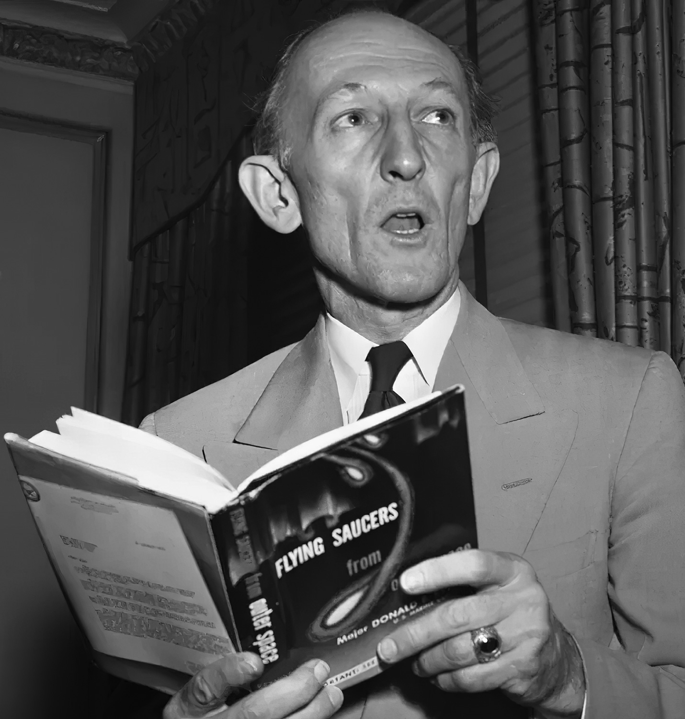
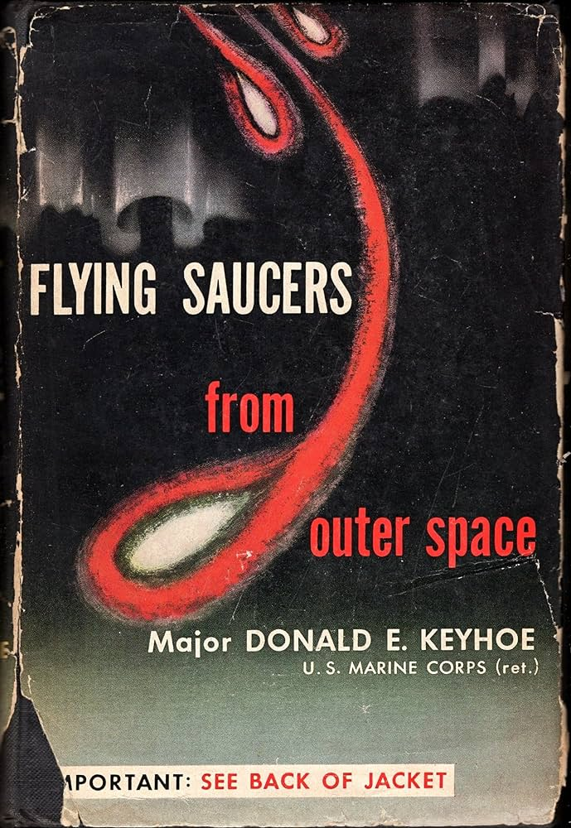
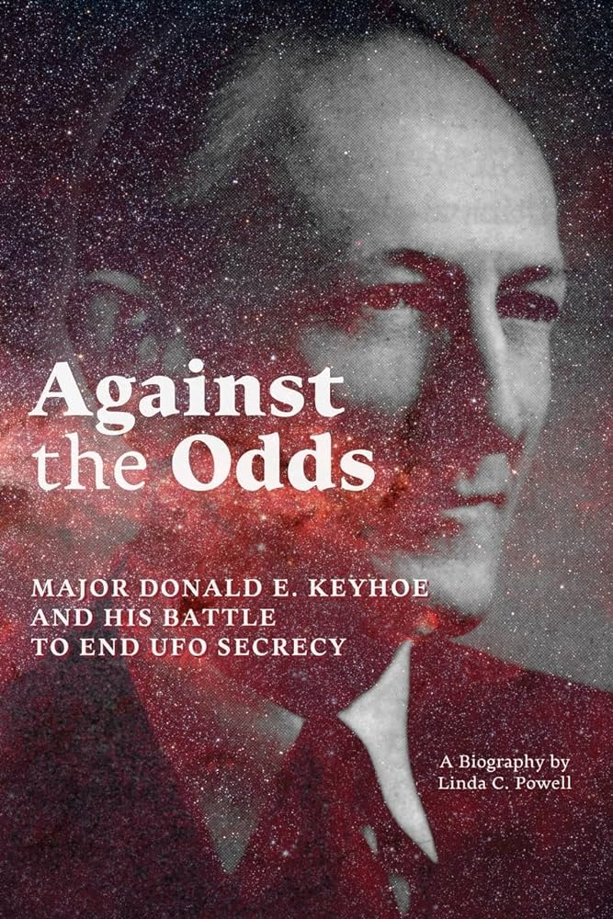
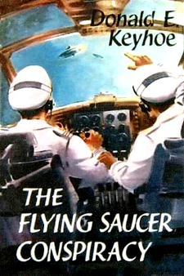

Major Donald
Keyhoe
Author and former Aviator
“The Flying Saucer Conspiracy”
Donald Keyhoe released "The Flying Saucer Conspiracy" two years following the incident. In the book, he speculated about the real reason behind the airmen's disappearance, suggesting that the vanished F-89 was chasing an alien spacecraft.
Keyhoe also wrote multiple other books on UFOs, aliens, and government cover ups. He was not the only person inspired by the Kinross incident, many other conspiracy and news organizations have investigated and been inspired by the disappearance

Slide 13
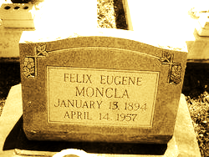
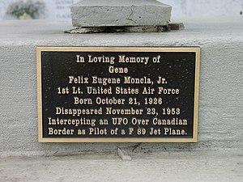
Memorials and Moving On
The active search for Moncla and Wilson was called off on the evening of November 28, 1953.
There were multiple other searches carried out by locals, family, and ufo enthusiasts, all fruitless.
The Moncla family did not give up hope, and waited until 1957 to erect a headstone, in hopes one day they would have remains to bury. Moncla’s wife eventually remarried and moved, and the Kinross Incident became nothing more than family lore to future generations.
A memorial was erected in Moreauville, LA, where Moncla spent his teens, to commemorate his disappearance in pursuit of a UFO.

Slide 14
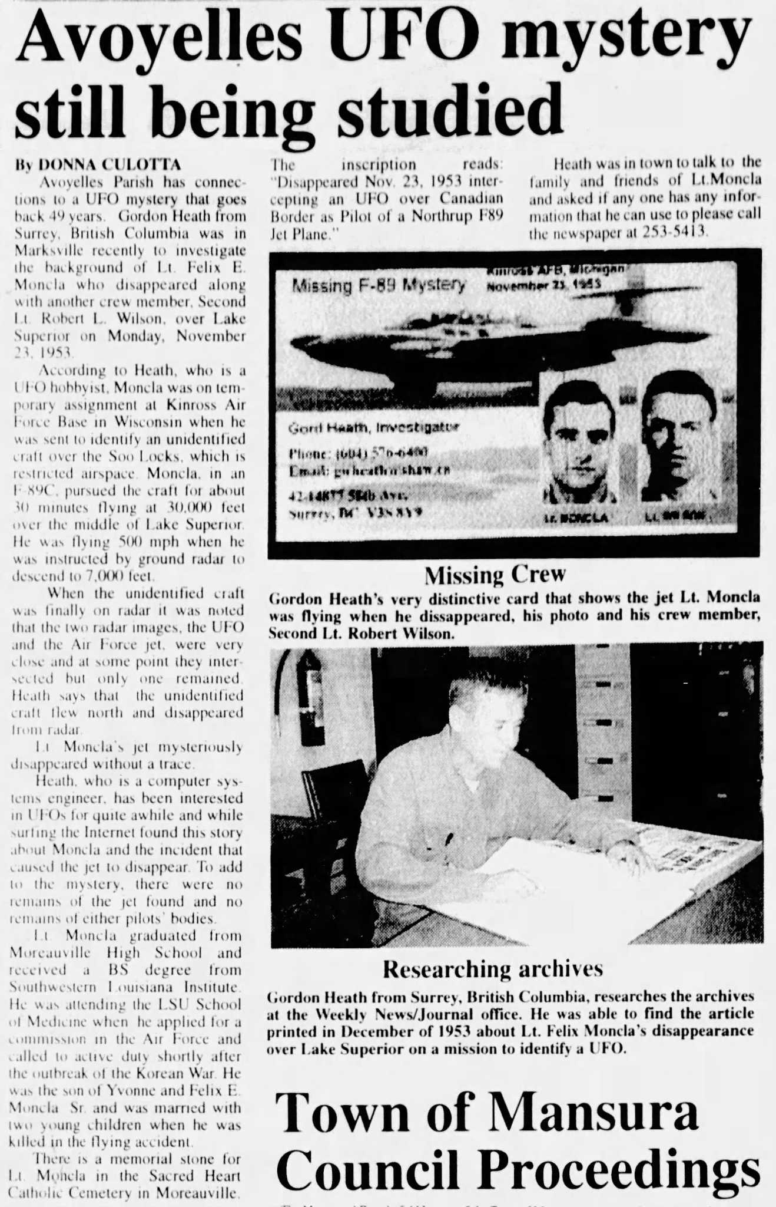



A simple mystery or complex conspiracy?
Whatever the cause of the F-89 C's disappearance was, it will remained unsolved until further information or evidence is uncovered. Unless the government decides to be completely honest or the aliens decide to return them, Moncla and Wilson’s case will remain an unsolved conspiracy.
?

Slide 15


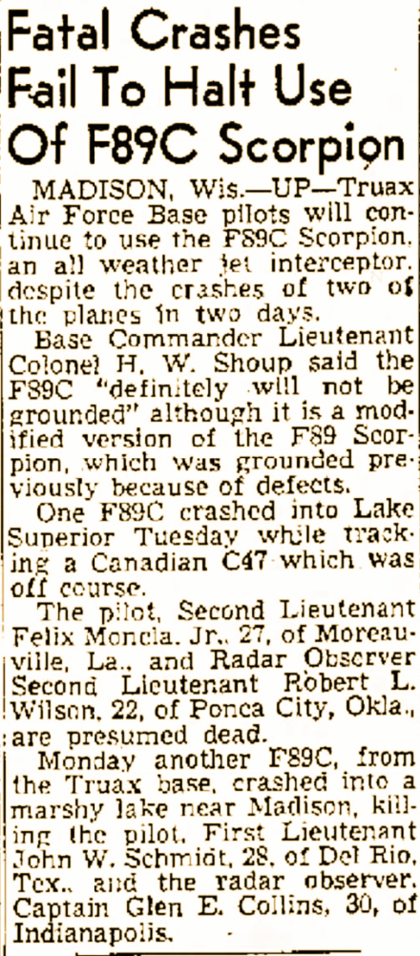
Citations:
“1953 : Air Force Jet Disappears Over Lake Superior in Pursuit of UFO.” MSU, Michigan Day by Day, 23 Nov. 2020, harris23.msu.domains/event/1953-air-force-jet-disappears-over-lake-superior-in-pursuit-of-ufo/.
Collins, David C. “KINROSS AFB MISSING F-89C - 23 NOV 1953 USAF REPORT OF AIRCRAFT ACCIDENT.” Department of the Air Forceheadquarters Air Force Safety Agency, DEPARTMENT OF THE AIR FORCE, www.cufon.org/kinross/Kinross_acc_rept.htm#images3. Accessed 20 Apr. 2024.
Editors of Publications International. “UFOs and the Government.” HowStuffWorks Science, HowStuffWorks, 8 Mar. 2023, science.howstuffworks.com/space/aliens-ufos/ufo-government4.htm.
“Felix Moncla (1926-1953).” Newspapers.Com, 26 Nov. 1953, www.newspapers.com/article/the-fresno-bee-felix-moncla-1926-1953/33479302/.
King, Darryn. “This Air Force Jet Was Scrambled to Intercept a UFO-Then Disappeared.” History.Com, A&E Television Networks, 7 Jan. 2020, www.history.com/news/ufo-fighter-jet-disappears-over-lake-superior-kinross-incident.
Little, Becky. “How the CIA Tried to Quell UFO Panic during the Cold War.” History.Com, A&E Television Networks, 6 Jan. 2020, www.history.com/news/ufo-sightings-cia-robertson-condon.
Moe, Doug. “A Mystery That May Never Be Answered.” Newspapers.Com, 14 Aug. 2013, www.newspapers.com/article/wisconsin-state-journal-page-2-kinross/59216525/.
Moncla, Virginia Kate, and Joy Moncla Youngblood. “Personal Family History Interview on Felix Eugene Moncla and The Kinross Incident.” 15 Apr. 2024.
Scott, Michael Dot. “The Mysterious Memorial Dedicated to Louisiana Pilot Who ‘disappeared Intercepting a UFO’ [Photo].” 97.3 The Dawg, Townsquare Media, 14 Aug. 2023, 973thedawg.com/memorial-louisiana-gene-moncla-pilot-disappeared-intercepting-a-ufo-photo/.
“USAF ACCIDENT REPORTS - 1953.” USAF Accident Reports - 1953, Aviation Archaeological Investigation & Research, www.aviationarchaeology.com/listPages/airforce/asp/AF_Monthly_1953.asp. Accessed 20 Apr. 2024.
“Wilson, Robert L., 2nd Lt.” TogetherWeServed, TWS, airforce.togetherweserved.com/usaf/servlet/tws.webapp.WebApp?cmd=ShadowBoxProfile&type=PersonAssociationExt&ID=47857. Accessed 20 Apr. 2024.

